Slide 1
A Renewed Commitment to Energy Justice
Dr. Tony G. Reames, Deputy Director for Energy Justice
GreenTown Climate & Equity Conference
June 22, 2023

Slide 2
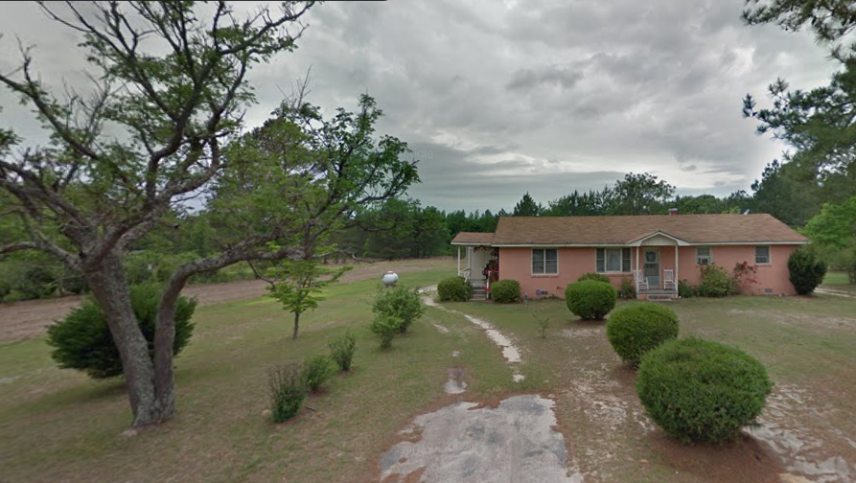

Slide 3
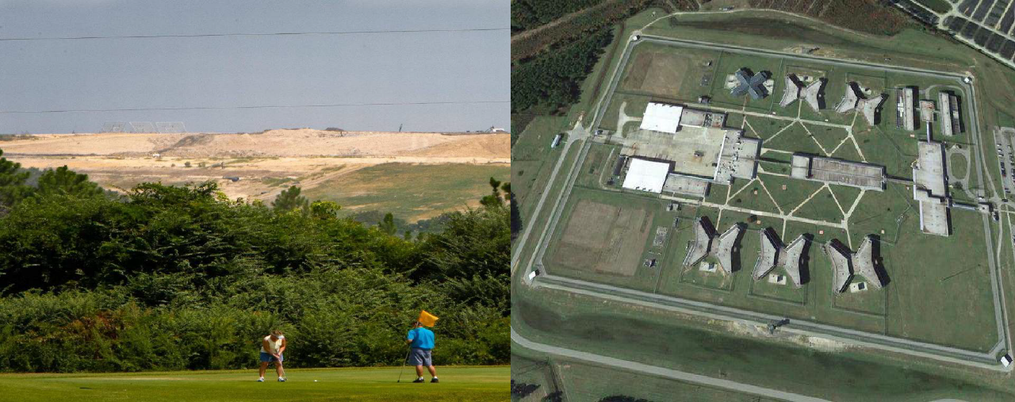
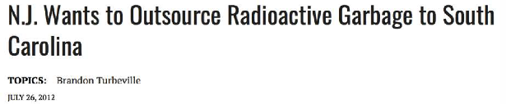
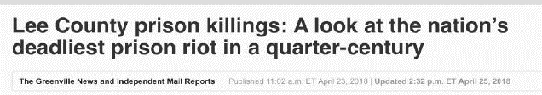
Lee County, South Carolina

Slide 4
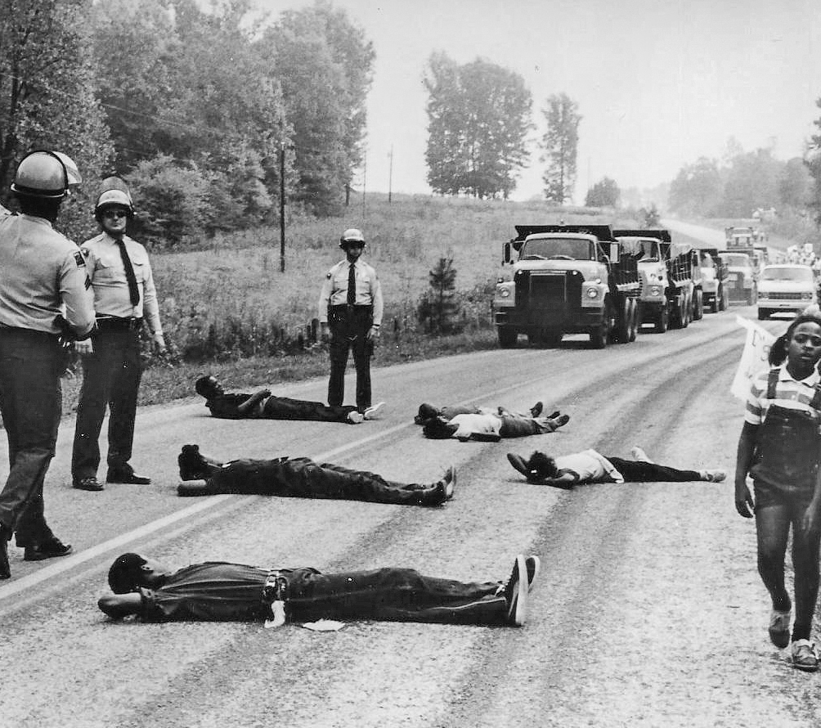
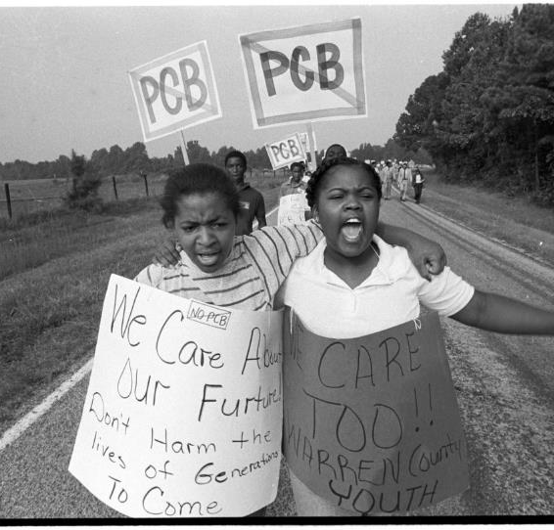
Environmental Justice Movement
Warren County, North Carolina, 1982

Slide 5
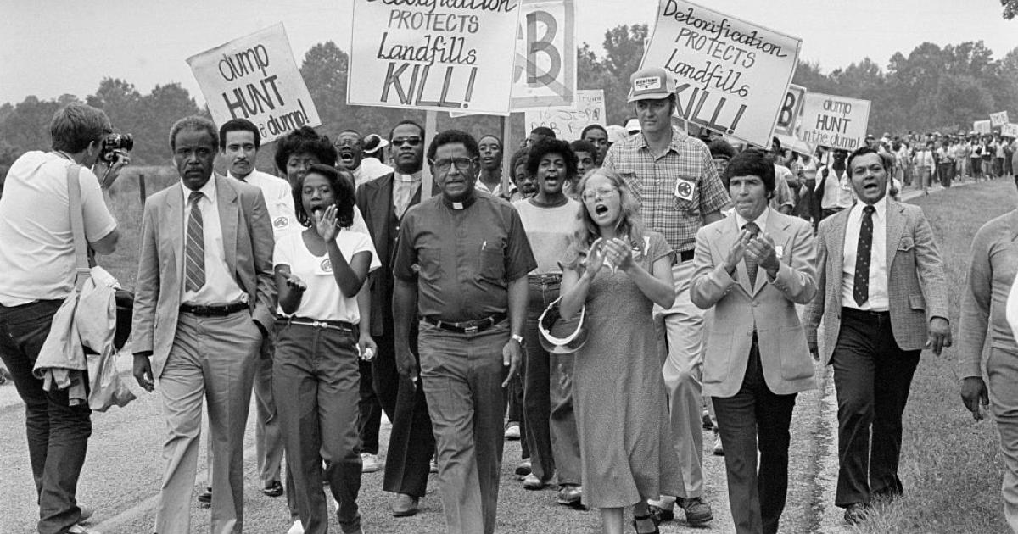
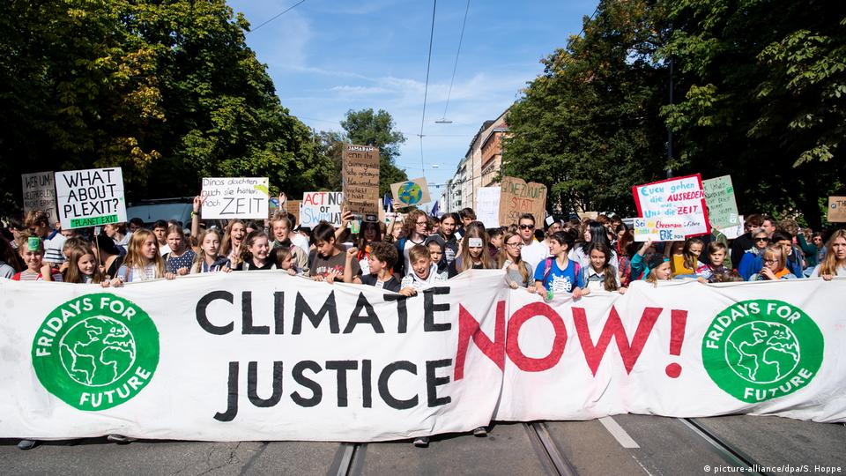
“The energy justice concept provides a more focused means to tackle injustices with environmental and climate knock-ons”
Environmental
Justice
Climate
Justice
Energy
Justice
Jenkins, K. (2018). Setting energy justice apart from the crowd: lessons from environmental and climate justice. Energy Research & Social Science, 39, 117-121.

Slide 6
What is Energy Justice?
Seeks equity in the social and economic participation in the energy system
While remediating social, economic, and health burdens on “frontline communities” explicitly centering their concerns
Aims to make energy more accessible, affordable, clean, and democratically managed for all communities.
A Call for Energy Justice
(4 Basic Rights)
Right to healthy, sustainable energy production
Right to the best available energy infrastructure
Right to affordable energy
Right to uninterrupted energy service
Sources: Initiative for Energy Justice (iejusa.org); Hernández, D. (2015). Sacrifice along the energy continuum: a call for energy justice. Environmental Justice, 8(4), 151-156.
Notes:
Similarto Environmental Justice, Energy justice refers to the goal of achieving equity in both the social and economic participation the energy system, while also remediating social, economic, and health burdens on marginalized communities. Energy justice explicitly centers the concerns of frontline communities and aims to make energy more accessible, affordable, clean, and democraticallymanaged for all communities.
It is intimately intertwined with Environmental Justice and Climate Justice, and we’ll see some of those links.
The current energy system has not yet achieved the vision of Energy Justice. There are several problems - energy insecurity and disproportionate harm and benefit.

Slide 7
Pillars of Energy Justice
Procedural
Recognition
Distributive
Restorative
Broad and meaningful participation in the decision-making
Respect and honor of divergent cultural and local knowledge
Equitable distribution of environmental benefits and burdens
Repair harms done to communities and the environment
Heffron and McCauley, The Concept of energy Justice Across the Disciplines, 105 Energy Policy 658, 659 (2017)
Notes:
What are your ideas to strengthen these pillars relative to the LD ESEE?

Slide 8

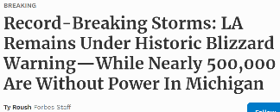
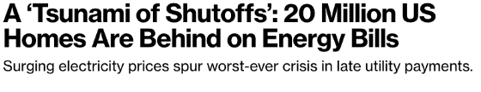
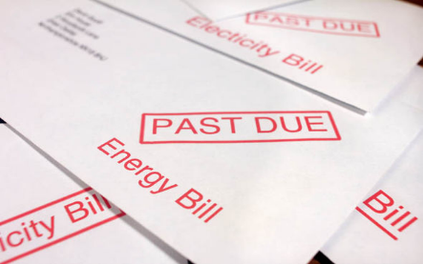
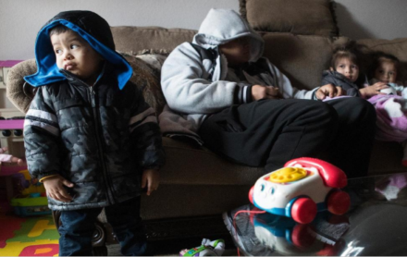
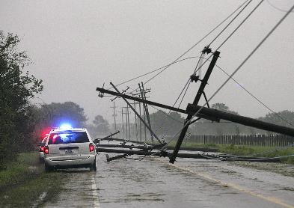





A Crisis of Energy Insecurity
8
Notes:
Residential Energy Insecurity:
The inability to adequately meet household energy needs, and includes physical, economic, and behavioral dimensions that may lead to or exacerbate adverse health issues
A multi-dimensional construct that describes the interplay between physical conditions of housing, household energy expenditures, and energy-related coping strategies (Hernandez, 2016)

Slide 9
National Energy Insecurity Stats
Sources: US Census Household Pulse Survey https://www.census.gov/data/data-tools/household-pulse-data-tool.html
US Energy Information Administration https://www.eia.gov/consumption/residential/

Slide 10

Energy Burden as a Metric of Energy Insecurity
3.5X
The median energy burden
of low-income households
is 3.5 times higher than
that of non-low-income
households
45%
The median energy burden
of Black households is
45% higher than that of
non-Hispanic white
households.
% of HHs experiencing high energy burden (> 6%)
25% of All US households (121.6 million)
36% of Black households (6.0 million),
36% of Native American households (541,155)
28% of Hispanic households (4.6 million)
23% of White households (22 million)
US median energy burden is 3.1%; median low-income energy burden is 8.1%. An affordable energy burden is < 6%
Source: https://www.aceee.org/energy-burden

Slide 11
Energy Burden and Public Health
A %
increase in energy burden
an average 240 more premature deaths per 100,000 people
7% increase in county residents that report experiencing fair or poor health
5-year decrease in average county life expectancy
Source: Reames, T. G., Daley, D. M., & Pierce, J. C. (2021). Exploring the Nexus of Energy Burden, Social Capital, and Environmental Quality in Shaping Health in US Counties. International Journal of Environmental Research and Public Health, 18(2), 620. https://www.mdpi.com/1660-4601/18/2/620/htm

Slide 12
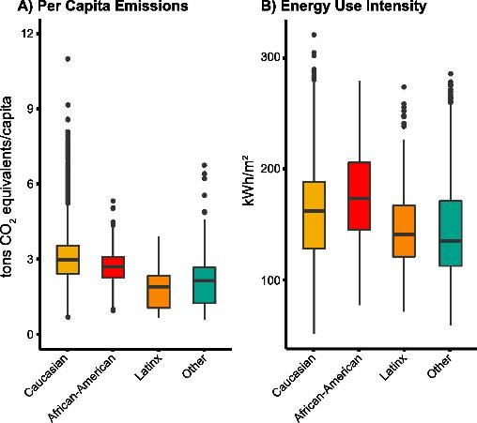
An emissions paradox
Modelled 60M US Households
Race plays a statistically significant role in determining home energy use and emissions
Per capita emissions are highest in majority Caucasian neighborhoods, followed by African-American neighborhoods, where emissions are 90% of those in Caucasian neighborhoods.
Latinx neighborhoods had the lowest per capita emissions, at only 60% of Caucasian neighborhoods.
Emissions from Other neighborhoods are 70% of those in Caucasian neighborhoods.
For African-American neighborhoods, there is an emissions paradox of high EUI and low per capita emissions.
Goldstein, B., Reames, T. G., & Newell, J. P. (2022). Racial inequity in household energy efficiency and carbon emissions in the United States: An emissions paradox. Energy Research & Social Science, 84, 102365.

Slide 13
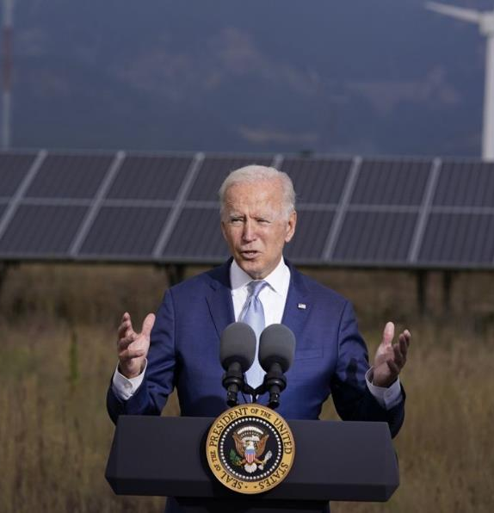
President Biden’s
Climate Goals
2022
2035
Reach 100% carbon pollution-free electricity
Reduce GHG Emissions 50-52% below 2005 levels
Achieve a net-zero emissions economy
2030
2050

Slide 14
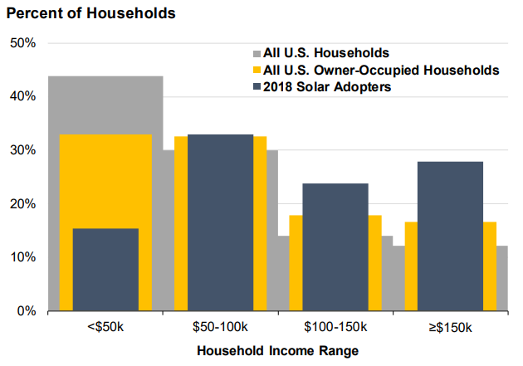
…But Disparities Exist
Geographic mismatch between technical potential and adoption (Chicago, IL)
Slower solar adoption by LMI households
Reames, T. G. (2020). Distributional disparities in residential rooftop solar potential and penetration in four cities in the United States. Energy Research & Social Science, 69, 101612.
Barbose et al. 2020 PowerPoint Presentation (lbl.gov)
Notes:
Participation in Solar
the ability to finance community production projects/ DER’s particularly constrains low-income groups
Often require a credit score or debt-to-income ratio that can be a barrier to low-income consumers
Low income groups do not qualify for the tax bracket for Solar Tax Credit incentives (ITC). Tribal entities and nonprofits cant access without direct payment option
Renters (more often lower incomes) have difficulty participating because of split incentives - the decision to participate is up to the land-lord even though the tenant would benefit most from a bill savings
Traps lower socio-economic groups in an energy system where they bear an increasing share of the cost of national infrastructure and are excluded from accessing the most economic means of energy supply.

Slide 15
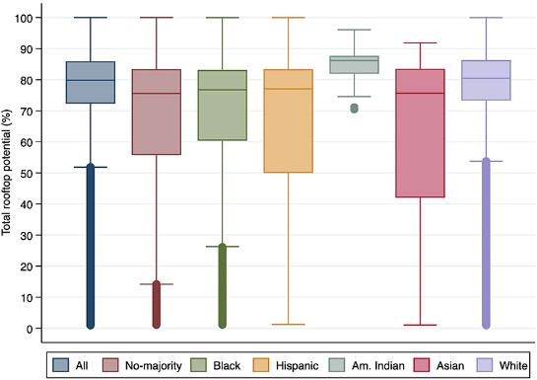
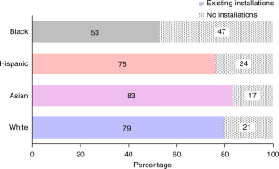
…But Disparities Exist
Percentages of each census tract with and without existing rooftop photovoltaic installations.
Racial/Ethnic Distribution of Total Rooftop Potential
Source: Sunter, D. A., Castellanos, S., & Kammen, D. M. (2019). Disparities in rooftop photovoltaics deployment in the United States by race and ethnicity. Nature Sustainability, 2(1), 71-76.
Source: Reames, T. G. (2021). Exploring residential rooftop solar potential in the United States by race and ethnicity. Frontiers in Sustainable Cities, 48.

Slide 16
…But Disparities Exist
$3.10
$6.25
Reames, T. G., Reiner, M. A., & Stacey, M. B. (2018). An incandescent truth: Disparities in energy-efficient lighting availability and prices in an urban US county. Applied energy, 218, 95-103.

Slide 17
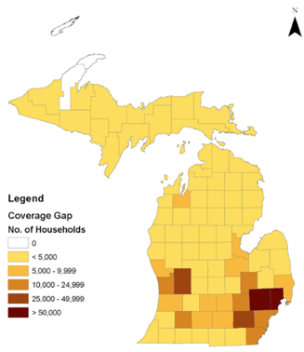
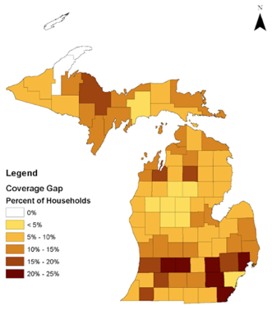

We can’t forget the missing middle
Energy Efficiency Donut Hole
1 in 8 (460,000) Michigan Households
Energy
Efficiency Coverage Gap
200% FPL
80% AMI
Credit Worthy
Government-funded
Coverage
Traditional Financing Coverage
Number of Households
Percent of Households

Slide 18

Our Grand Challenge
How do we simultaneously transform our energy system and create a energy system that is more equitable and just?
Notes:
We face a climate emergency that threatens vulnerable communities.
We have many of the technical tools to avert catastrophic climate change and transition to a clean energy system; however, how do we transform our energy system while also ensuring equity?

Slide 19
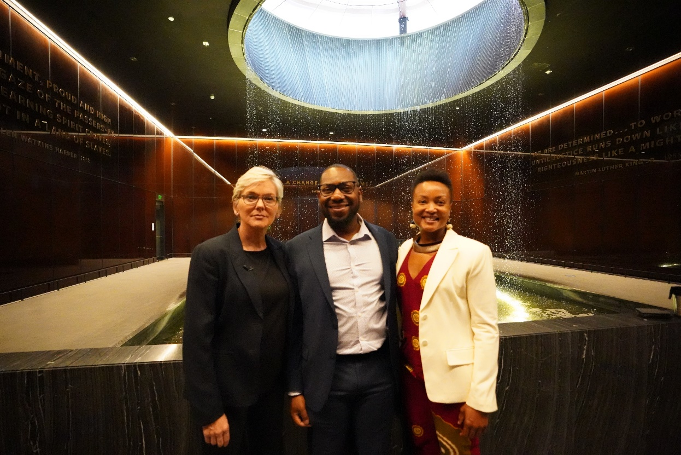
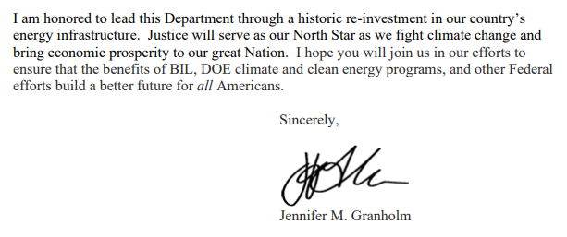
“Justice will serve as our North Star”
Secretary Granholm, Deputy Director Reames, Director Baker

Slide 20
Office of Economic Impact & Diversity
The National Energy Conservation Policy Act of 1978 (Public Law 95-619,Title 6, Part 3) created the Office of Minority Economic Impact now Office of Economic Impact and Diversity
The statute outlines 4 key areas of focus
Advise the Secretary of Energy on the effect of energy policies, regulations and other actions on people and communities of color, and minority-owned businesses.
Conduct an ongoing research program to determine the effects (including socioeconomic and environmental effects) of national energy programs, policies and regulations on communities of color.
Provide technical assistance to minority educational institutions and business enterprises to foster participation in research, development, demonstration, and contract activities of DOE.
Provide financial assistance in the form of loans to any minority business enterprise to assist such enterprises in participating fully in research, development, demonstration, and contract activities of DOE.

Slide 21
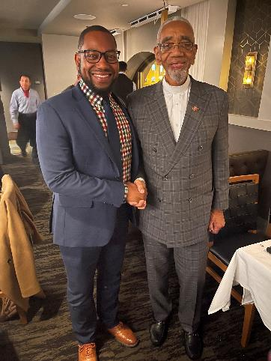
Office of Energy Justice Policy & Analysis, FY22
H.R. 1375 – Energy Equity Act of 2021
This bill would have established an Office of Energy Equity within the Department of Energy to:
promote an agencywide environmental justice strategy and interagency collaboration,
reduce or stabilize energy costs within underserved or disadvantaged communities, and
increase the availability of energy conservation measures within underserved or disadvantaged communities.
(Introduced by Rep. Bobby Rush 2/25/21)
Dr. Reames with Rep. Bobby Rush, Dec 2022

Slide 22
The Justice40 Initiative
EO 14008, Sec 223 – Justice40 – how Federal investments might be made for 40% of the overall benefits to flow to disadvantaged communities
Federal investments
40% of the overall benefits
Disadvantaged communities
How do we define Justice40 investments and identify programs?
How do we measure and track the benefits of Justice40 investments?
How do we define disadvantaged communities (DACs)?
Interim Implementation Guidance for the Justice40 Initiative. https://www.whitehouse.gov/wp-content/uploads/2021/07/M-21-28.pdf
Notes:
EO 14008 – Tackling the Climate Crisis at Home and Abroad
Tackling the Climate Crisis at Home & Abroad
January 24, 2021
Establishes WHEJAC & Justice40 Initiative.
Whole of government approach making it a priority that Justice be central to every program, process, policy, and payment.
The Office of Economic Impact and Diversity (ED) is guiding how to:
Define DACs at census tract level incorporating 36 indicators
Identify Policy Priorities relevant to J40 Investment Categories
Helping programs calculate relevant metrics
Define key terms and goals and create a supporting measurement framework, infrastructure, and processes to both establish a baseline and then track progress on Justice40
--------
3 Questions:
1. Which programs and policies should be included in Justice40 (as well as which agencies, and where applicable specific offices, are relevant to recommendation implementation)?
2. What are the key elements that are important in developing definitions of “investment benefits”?
3. What are the key elements that should be included in defining “disadvantaged communities?”
WHEJAC Recommendations for Justice40 are broken up to address 3 prime questions as follows.
Question 1 is given the most space throughout the report & addresses the 8 buckets of programs that we will touch on is just a second (such as clean energy and efficiency) with specific mentions to relevant agencies, intra-agency collaboration, and new legislation required to meet Justice40 goals.
The report also address 2 additional topics outside of Justice40:
Recommendations for a Climate & Economic Justice Screening Tool
Define tool: Exec. Order 14008 establishes the creation of a geospatial Climate and Economic tool and shall annually publish interactive maps highlighting disadvantaged communities by July 2021.
Recommendations for revisions to Executive Order 12898
Define: Executive order 12898, aka Federal Actions to Address Environmental Justice in Minority Populations and Low-Income Populations, was issued by President Clinton in 1994. Its purpose is to focus federal attention on the environmental and human health effects of federal actions on minority and low-income populations with the goal of achieving environmental protection for all communities.
Tackling the Climate Crisis at Home & Abroad
January 24, 2021
Establishes WHEJAC & Justice40 Initiative.
Established timeline of 120 days for CEQ/OMB/Climate office to publish recommendations to achieve Justice40 mandate in consultation with DACs.
Established to Advise Chair of the Council on Environmental Quality (CEQ) & White House Environmental Justice Interagency Council (EJIAC) on a “whole of government” approach to Environmental Justice.
The WHEJAC (26) members represent a diverse set of geographical regions and serve in a voluntary capacity.

Slide 23





Implementing Justice40
White House Environmental Justice Advisory Council (WHEJAC)
President
Council on Environmental Quality (CEQ)
Office of Management and Budget (OMB)
Climate Policy Office (CPO)
White House Environmental Justice Interagency Council (WHEJIC)
Secretary of Energy
(19 Other Federal Agencies)
Office of Economic Impact & Diversity
External Stakeholder Engagement & Input
Office of Energy Justice Policy & Analysis
Justice40
Benefits Metrics Working Group
Justice40
Community of Practice
Energy and Environmental Justice (EEJ) Working Group
Stakeholder Engagement
Community of Practice

Slide 24
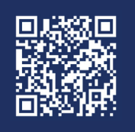
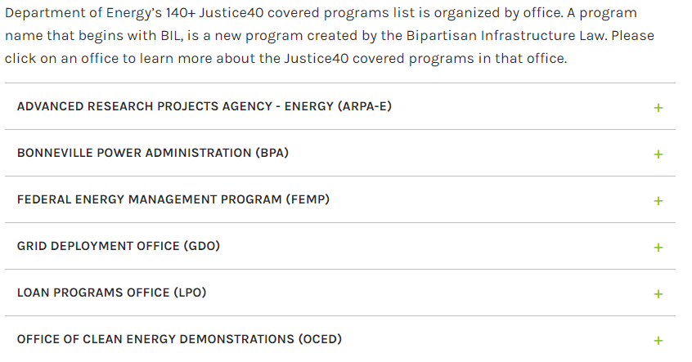
DOE’s Justice40 Covered Programs
23
Program Offices
144
Covered Programs
Climate change
Clean energy and energy efficiency
Clean transportation
Affordable and sustainable housing
Training and workforce development
Remediation and reduction of legacy pollution
Critical clean water and waste infrastructure
Learn more: https://www.energy.gov/diversity/doe-justice40-covered-programs
As of 7/25/22

Slide 25
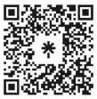
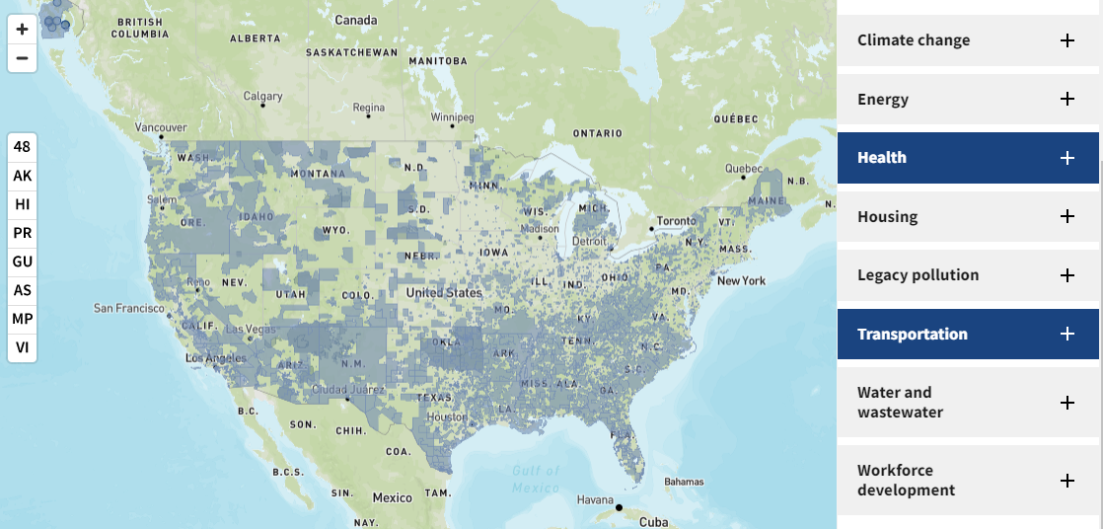
Identifying Disadvantaged Communities
CEQ’s Climate & Economic Justice Screening Tool (CEJST)
November 2022, CEQ CJEST v1.0 Released
27,248 census tracts as disadvantaged (36.8% total U.S. census tracts)
~28% of the total U.S. population lives in a CEJST disadvantaged community
October 2023, All Agencies expected to use the CEJST for any new announcements
Source: https://screeningtool.geoplatform.gov/en/#3/33.47/-97.5

Slide 26
Guiding Policy Priorities for Justice40 Benefits for disadvantaged communities
Decrease energy burden
Decrease environmental exposure and burdens
Increase parity in clean energy technology access and adoption
Increase access to low-cost capital
Increase clean energy enterprise creation and contracting (MBE/DBE)
Increase clean energy jobs, job pipeline, and job training for individuals
Increase energy resiliency
Increase energy democracy

Slide 27

We have a ONCE IN A GENERATION OPPORTUNITY to transform Our energy system
Growing dependence on energy
Increased disruptions from climate change extremes
Increased risks of attacks on critical infrastructure
Exacerbation of historic and persistent harms
A vocal, eager & engaged public
Major investments devoted to the clean energy transition

Slide 28



New Laws Will Revolutionize U.S. Energy Sector
The Backbone: Bipartisan Infrastructure Law or BIL (November 2021) makes the largest long-term investment in our nation’s infrastructure in nearly a century.
The Brain: CHIPS and Science Act (July 2022) invests in cutting-edge science and innovation to boost American competitiveness, including for semiconductors, and to bring jobs and supply chains home.
The Lungs: Inflation Reduction Act or IRA (August 2022) breathes life into our clean energy economy by incentivizing deployment of clean technologies and lowering energy costs for American families.
Notes:
The Inflation Reduction Act (IRA) is a wide-reaching law that promises to aid in the nation’s COVID-19 recovery, bolster the economy, lower healthcare costs, and address climate change. In fact, IRA is the single largest investment in climate action in our nation’s history. Together, IRA and the Bipartisan Infrastructure Law (BIL) invest more than $430 billion in the nation's energy system.
Not only do IRA’s climate provisions aim to lower greenhouse gas (GHG) emissions, they also:
Save consumers money
Create quality jobs
Provide long-term stability for manufacturers and investors
Improve public health
Empower disadvantaged communities to take advantage of the clean energy revolution

Slide 29




















DOE BIL` at a Glance
~$ 62 B
Hydroelectric Production ~ 125 M
Hydroelectric Efficiency ~ 75 M
Hydroelectric Incentives ~ 554 M
Hydro power R&D ~ 146 M
Nuclear Credit ~ 6 B
Adv. Reactor Demo ~ 2.5 B
Plug Orphan wells ~ 30 M
Grid Hardening ~ 5 B
Grid Reliability and Resilience ~ 6 B
Transmission ~ 50 M
Smart Grid ~ 3 B
Pumped Storage +
Wind & Solar Integration ~ 10 M
Solar and Wind ~ 264 M
Direct Air Capture ~ 3.5 B
Carbon Utilization ~ 310 M
Carbon Capture ~ 100 M
CO2 Transport ~ 2.1 B
C Storage ~ 2.5 B
Geological Permitting ~ 50 M
Carbon Capture Demo ~ 3.5 B
Direct Air Capture Prizes ~ 115 M
Hydrogen Hubs ~ 9.5 B
Public schools EE ~ 500 M
Federal Facilities ~ 250 M
Building Codes ~ 225 M
Weatherization ~ 3.5 B
Energy Efficiency ~ 250 M
EE Block Grants~ 550 M
Battery ~ 6 B
Energy Storage
Demo ~ 505 M
Mineral Mining ~ 100 M
Rare Earth Security ~ 802 M
Mineral Research ~ 167 M
Rare Earth Elements ~ 140 M
Clean energy demos on mine land ~ 500 M
State mfcg ~ 50 M
EE Materials ~ 50 M
Adv. Energy Mfcg ~ 750 M
Industrial Research ~ 550 M
State Energy Programs ~ 500 M
Industrial Emissions Demo ~ 500 M
Energy Efficiency ~ 250 M
EV Battery
2nd life ~ 200 M
Rebates ~ 20 M
Cybersecurity ~ 250 M
Cyberresilience ~ 350 M
Energy auditors ~ 40 M
Training Centers ~ 10 M
Skills Training ~ 10 M

Slide 30
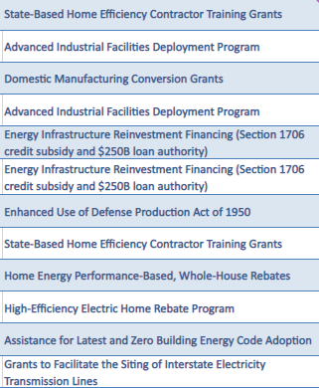
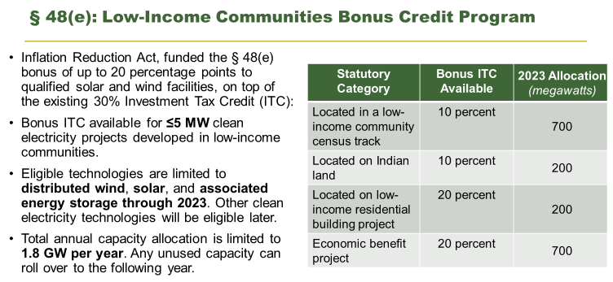
Inflation Reduction Act (IRA)

Slide 31

CHIPS and Science Act
Advance U.S. global leadership in the technologies of the future including semiconductors and wireless supply chains
$10B to catalyze regional economic growth and development through innovation and technology hubs across the country
Provide STEM opportunities for more Americans to participate in good-paying skilled jobs including new initiatives HBCUs, HSIs, other MSIs
Accelerate the commercialization by raising and investing funds from private sector and philanthropic communities through The Foundation for Energy Security and Innovation (FESI)

Slide 32




Prioritizing Communities
Community & Labor Engagement
DOE BIL and IRA funded programs require applicants to include a Community Benefits Plan to help ensure broadly shared prosperity in the clean energy transition.​
By prioritizing community benefits, we can ensure the next chapter in America's energy story is marked by greater justice, equity, security, and resilience.
Diversity, Equity, Inclusion, &
Accessibility
Investing in the American Workforce
Justice40 Initiative

Slide 33
What is a Community Benefits Plan? ​
A Community Benefits Plan (CBP) is a new requirement added to all Funding Opportunity Announcements (FOAs). The Community Benefits Plan is typically valued at 20% of the overall score of the application.
The CBP should outline: ​
How the applicant intends to achieve DOE's priority areas of Justice40, Diversity, Equity, Access & Inclusion (DEIA) & Quality Jobs; and Community and Labor Engagement.
A Specific, Measurable, Assignable, Realistic, & Time-Based (SMART) milestone, per budget period, to measure progress on the proposed CBP actions.
If the project is selected:
DOE will incorporate the CBP into the award and the recipient will be required to implement the CBP as proposed. ​
During the life of the award, DOE will evaluate the recipient’s progress, including as part of the "Go/No-Go" review process.

Slide 34
Bringing it all Together: A Layered, Collaborative Approach to Achieving Energy Justice
Federal: R&D, Technical & Financial Assistance
Philanthropy & Communities: Community and MBE/DBE capacity building
Private Sector: Unlock long-term, transformative investment
State and Local: Local planning, Federal $ recipients, regulatory authority
Notes:
We’ll bring together all of the key elements of the stakeholders in the ecosystem who are currently working to make Justice40 a reality:
DOE, in partnership with our Federal partners, will bring TA and deployment support to underserved/overburdened communities.
We will partner with philanthropy to build capacity for communities to receive Federal and private sector dollars.
And, the private sector is already positioning itself to make deep investments on Justice40. We hope to leverage this excitement to bring long-term and transformative investments to underserved communities.

Slide 35
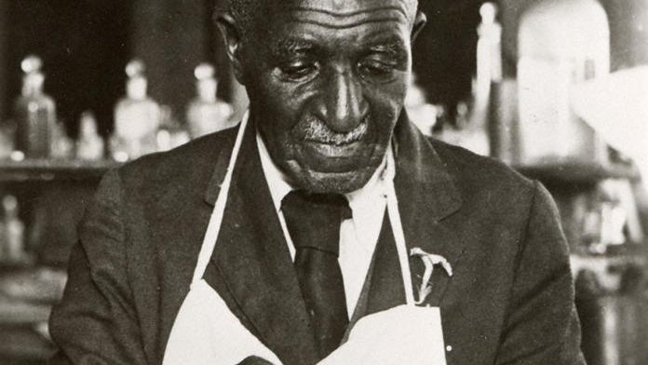
“When you can do the common things of life in an uncommon way, you will command the attention of the world.”
George Washington Carver

Slide 36


Thank you!
Tony G. Reames, PhD, PE
Deputy Director for Energy Justice
Office of Energy Justice Policy & Analysis
energyjustice@hq.doe.gov
Resources
www.energy.gov/Justice40
www.energy.gov/diversity
OFFICE OF
ECONOMIC IMPACT AND DIVERSITY

