Slide 1
Greening Chicago Metro Area Businesses
John Harris, a5 Branding and Digital
Cassie Carroll, SEDAC
Mohammed Elahi, Cook County Government
Krista Elam, Cook County Government
Ravi Parakkat, Takeout 25
Cara Pratt, Sustain Evanston

Slide 2










The Illinois Green Business Program
The Illinois Green Business Program was founded in 2008 by the Illinois Green Business Association (IGBA) and is run by SEDAC
Mission: Make it easier for businesses to go green & reduce climate emissions
Bring national expertise to Illinois businesses
Sustainable business as a standard practice in IL
Current Projects:
Green Business Baseline
Sustainability technical assistance
Expanding data collection in green business programs nationally
Starting Illinois’ first green dining hub
Notes:
SEDAC and the Illinois Green Business Association have adopted the Oak Park community as an area of focus in the state of Illinois because:
This region is a food hub in the region.
This region is a sustainability leader in the Chicagoland area, we want to work with you to grow that notoriety even further
This region is unique in that it has a thriving business district and restaurant scene.
We want to help your business increase resilience through sustainable practices, but we also want to launch the first green dining hub in Illinois in Oak Park with each and every one of you.

Slide 3

Takeout 25
A community driven approach to sustainability & economic development
Highlights
Started in 2020
6 communities
12,800 community members
~100 restaurant members
Not for profit – 501(c)(6)
Visit www.takeout25.org
Enable Sustainability
Develop local economy
Address Food insecurity
Building Illinois’ first green dining hub
in a commercially responsible way.

Slide 4
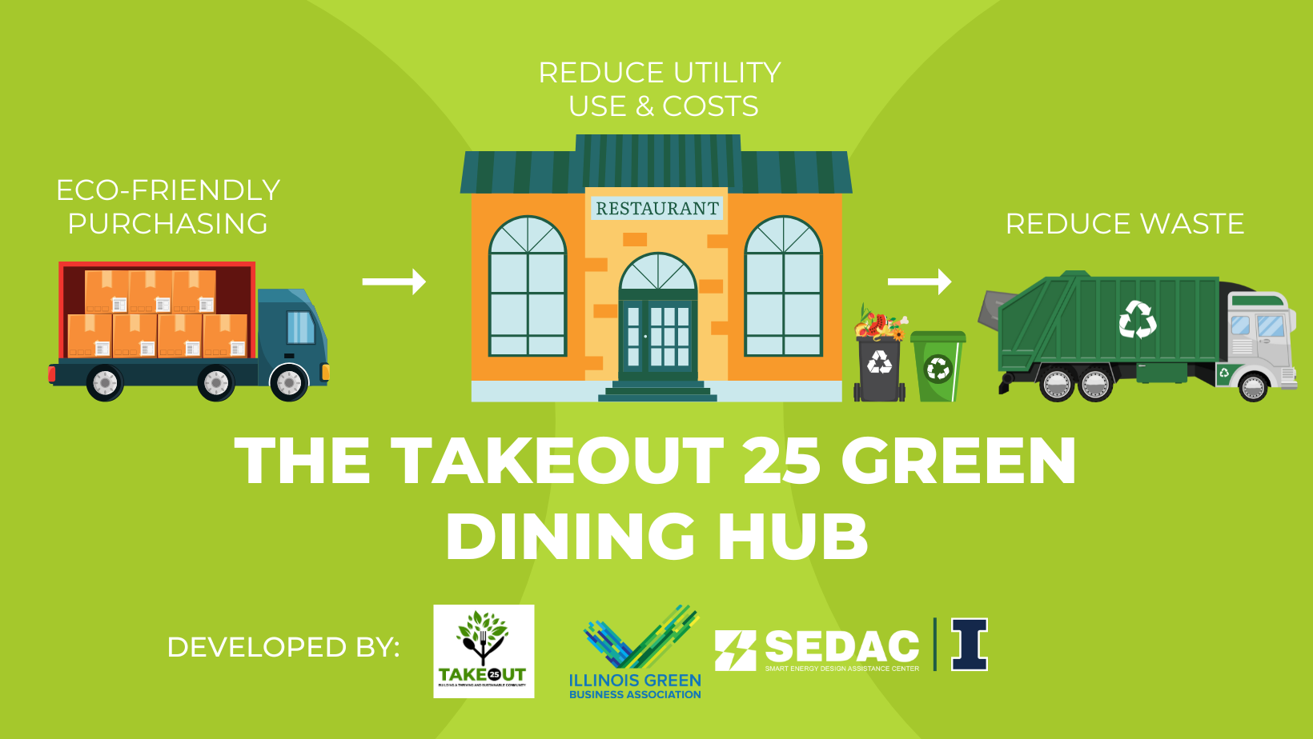
Next Steps
Recruit 25 restaurants to participate in the Hub (3 more to go!)
Complete Assessments (18 complete, 5 scheduled)
Identify unique and collective action sustainability strategies
Prepare for Hub launch (late summer 2023)
Notes:
Follows the STL Green Dining District Model – 25% of a district/region
Connect businesses to available resources, leverage collective interests/buying power for collaboration & efficiency

Slide 5

The “Sustain Evanston” Story
Is your Institutional Climate Plan RELEVANT to Local Businesses?
Cara Pratt
Sustainability & Resilience Manager
June 22, 2023

Slide 6


Evanston’s
Climate Action & Resilience Plan

Slide 7

Sustain Evanston 2023
6 approved applications; 6 pending applications
HVAC
Energy efficient appliances
3D printer for plastic reuse
Compost services
New windows and doors
Pocket park
Electric vehicle and EV charging

Slide 8
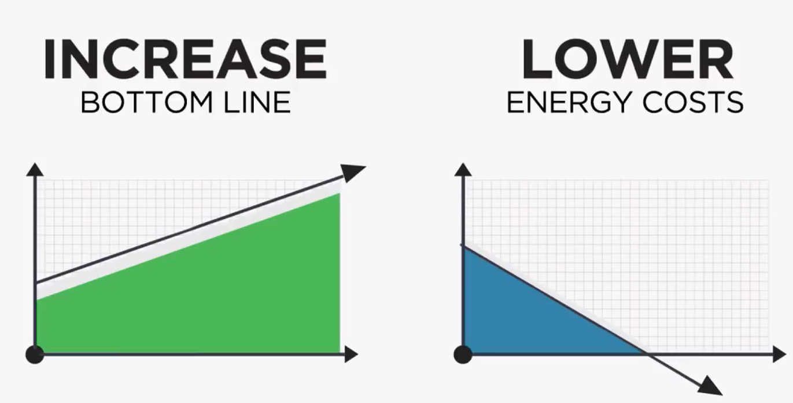
CPACE Program Overview
What is CPACE? Commercial Property Assessed Clean Energy
CPACE is a financing tool to assist commercial property owners with financing improvements to their property, such as:
  Energy Efficiency Projects, Water Use Improvements, Renewable Energy Installations, Resiliency Improvements, Electric Vehicle Charging Infrastructure, and More
Authorizes voluntary assessment contracts that secure CPACE financings for eligible projects.
Assessments “run with property” and do not accelerate, nor become due on sale of the property.
CPACE financings are funded with private capital sources and may be repaid on the property tax bill. Pre-payable.
Project Types: New construction, renovations, equipment installation, adaptive reuse, refinance
Program Details: www.cookcountyil.gov/cpace
Questions? Email mohammed.elahi@cookcountyil.gov

Slide 9









CPACE Program Overview
Eligible C-PACE Projects
Why CPACE?
Finance up to 100% of eligible costs
  No personal guarantees
  Frees up equity for other priorities
Fixed rate, long-term: up to 20 – 30 years
  Yields positive cash flow
  Boost Property Value
Tenants may share cost & savings
Potential off-balance sheet treatment
Reduce waste & improve experience
www.cookcountyil.gov/cpace
OFFICE
INDUSTRIAL
MULTIFAMILY
RETAIL
HEALTHCARE
HOSPITALITY
NONPROFIT
AGRICULTURAL
MIXED USE

Slide 10
Businesses Reducing Impact on the Environment (BRITE) Program Overview
Goal of the Program:
Reduce pollution from business operations by offering free on-site technical assessments that help businesses identify pollution reduction opportunities, costs of implementation, and business cost savings. Grant funding may be offered to qualified businesses.
Participant Eligibility:​
The BRITE Program will initially focus on dry cleaners, auto body & auto repair shops, metal finishers, and food and beverage manufacturers in socially vulnerable areas of Suburban Cook County.
Social Vulnerability Index Map: https://maps.cookcountyil.gov/svi/
  Focusing outreach to municipalities with scores of .60 or higher
Why these businesses?​
These business types have a large environmental footprint and are a primary focus of the Environmental Protection Agency (EPA). Many of these businesses are also located in socially vulnerable areas throughout the County.
Cook County Department of Environment and Sustainability expects to reduce pollution at these businesses while supporting the enhancement of business operations.
Program Details:
Will open to Food and Beverage Manufacturers this summer
Webpage: www.cookcountyil.gov/BRITE and Interest Surveys in English, Spanish, and Korean
Questions? Email BRITE@cookcountyil.gov

Slide 11
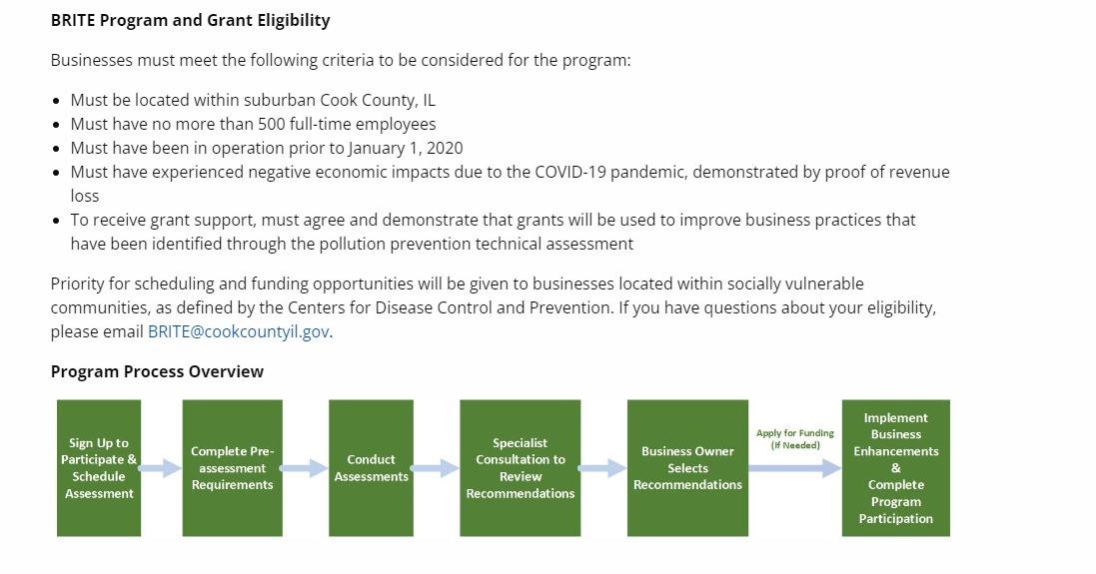
BRITE Program Eligibility and Process Overview

Slide 12
Greening Chicago Metro Area Businesses
John Harris, a5 Branding & Digital
Cassie Carroll, SEDAC
Mohammed Elahi, Cook County Government
Krista Elam, Cook County Government
Ravi Parakkat, Takeout 25
Cara Pratt, Sustain Evanston

